Slide 1
Explaining the spatial pattern of debris flow and flood hazard in High Mountain Asia
Varya Bazilova,
Tjalling de Haas, Walter Immerzeel

Slide 2

Explaining the spatial pattern of debris flow and flood hazard in High Mountain Asia
Varya Bazilova,
Tjalling de Haas, Walter Immerzeel

Slide 3
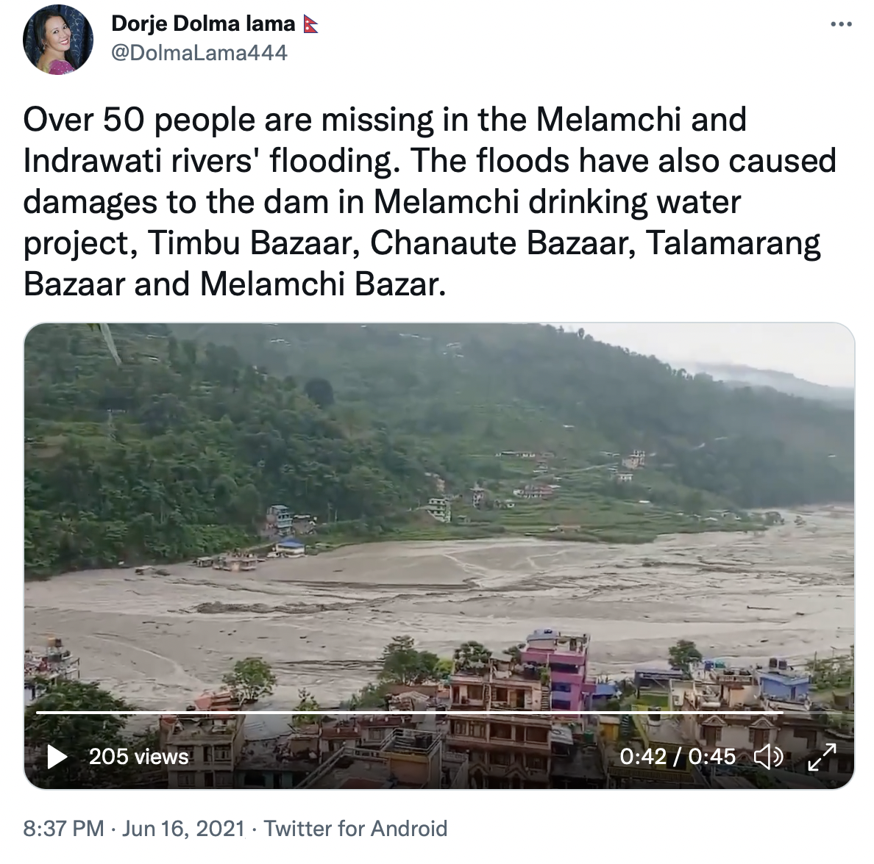

Slide 4
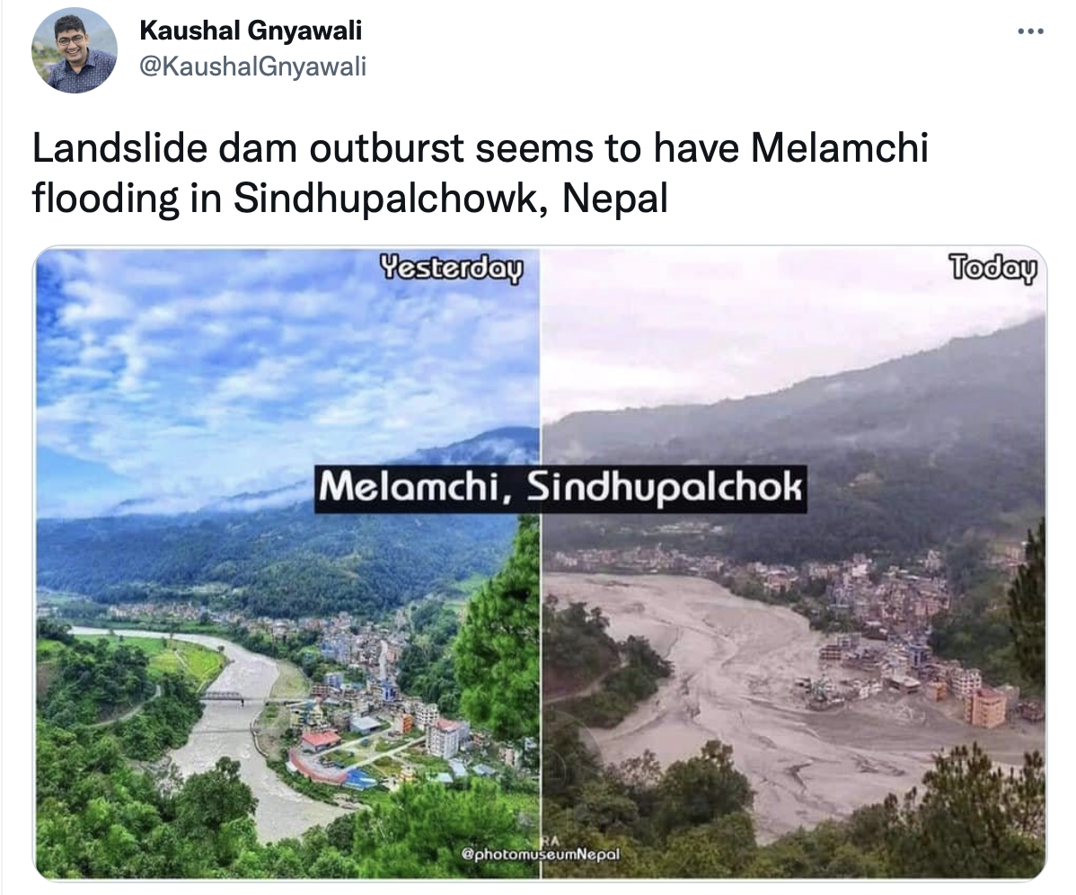

Slide 5
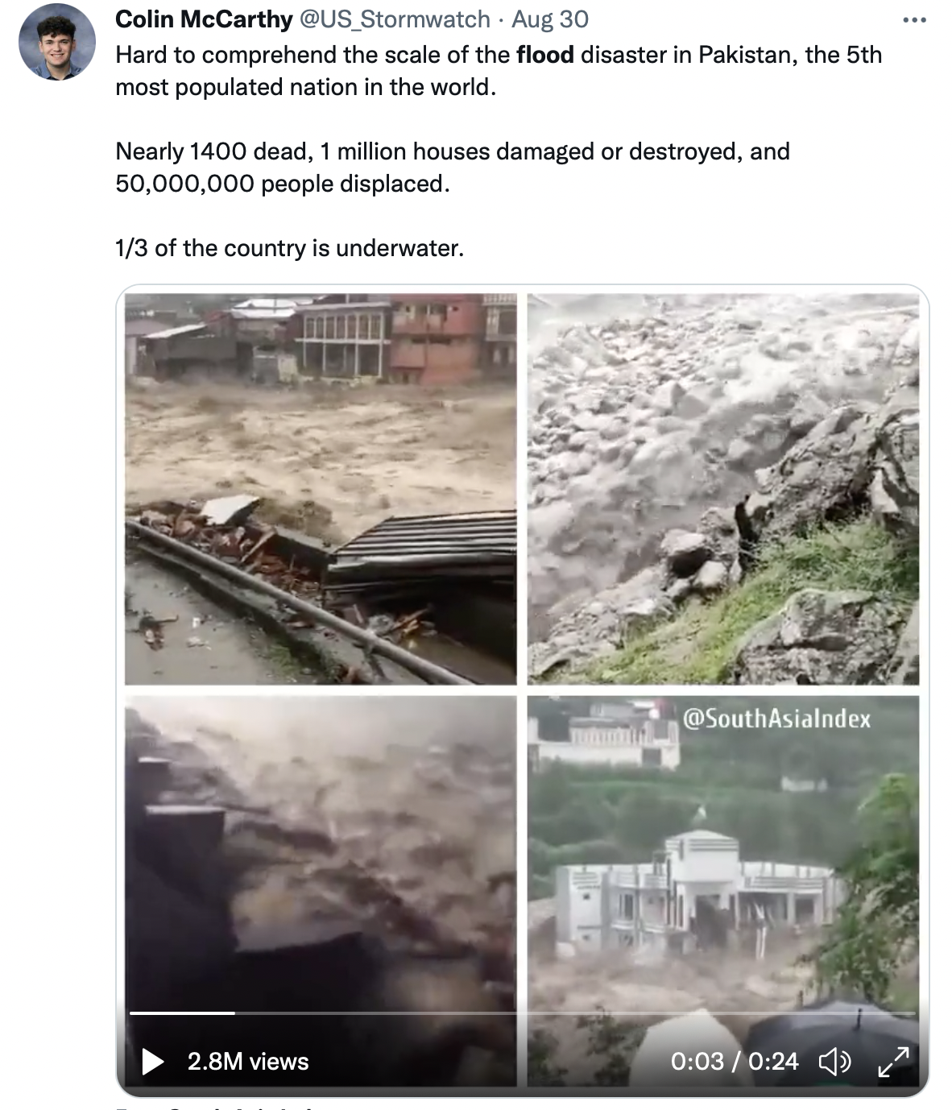

Slide 6
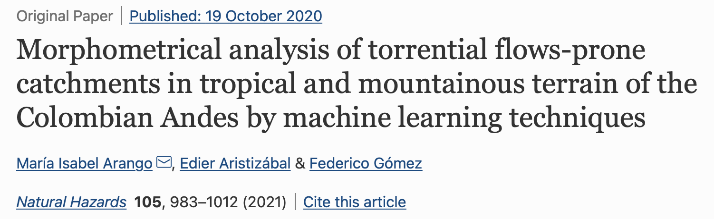

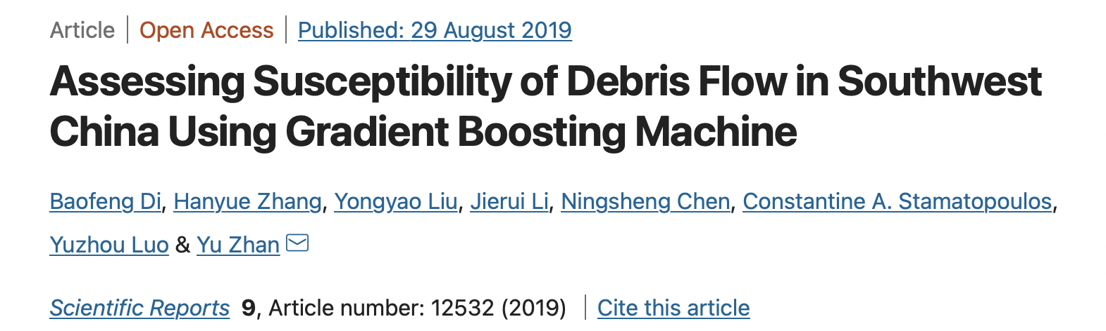


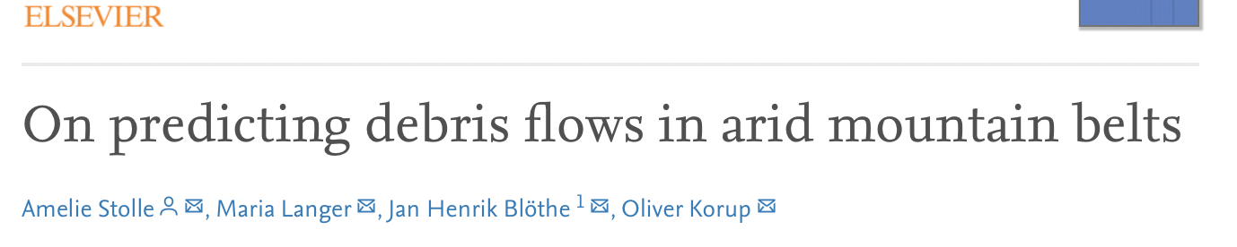

Slide 7
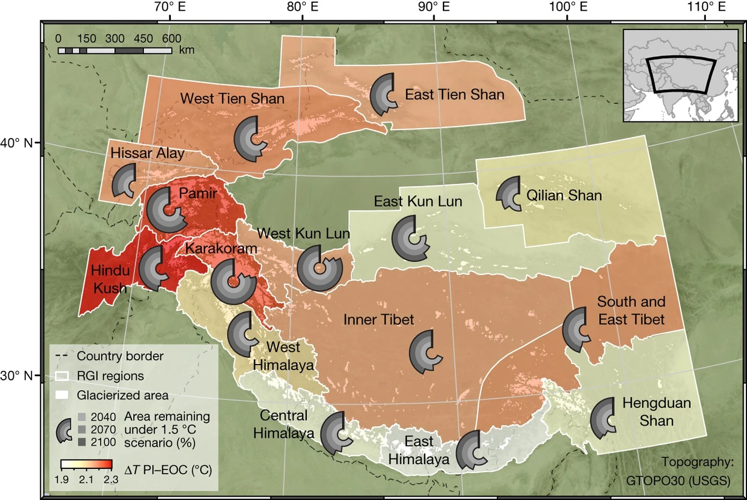

What is happening in HMA?
Impact of a global temperature rise of 1.5 degrees Celsius on Asia’s glaciers (P. Kraaijenbrink et al., 2017)

Slide 8
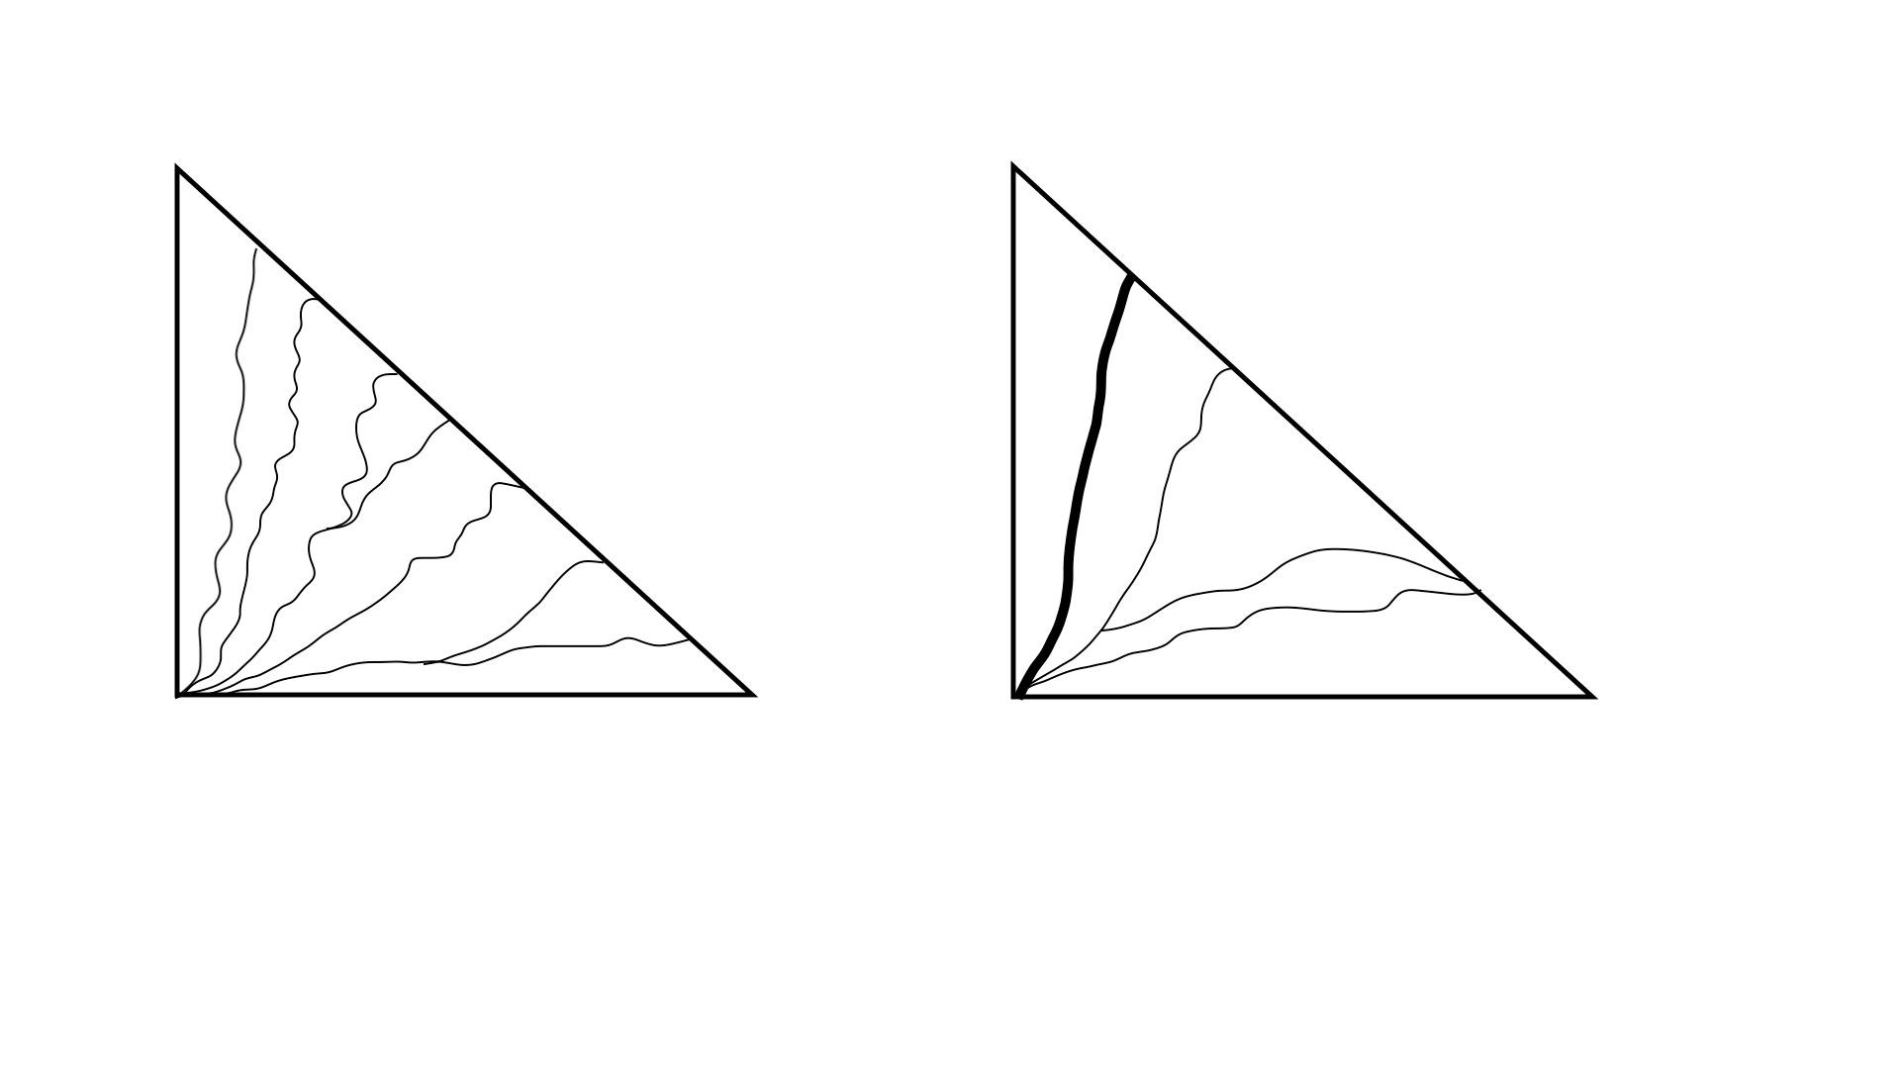
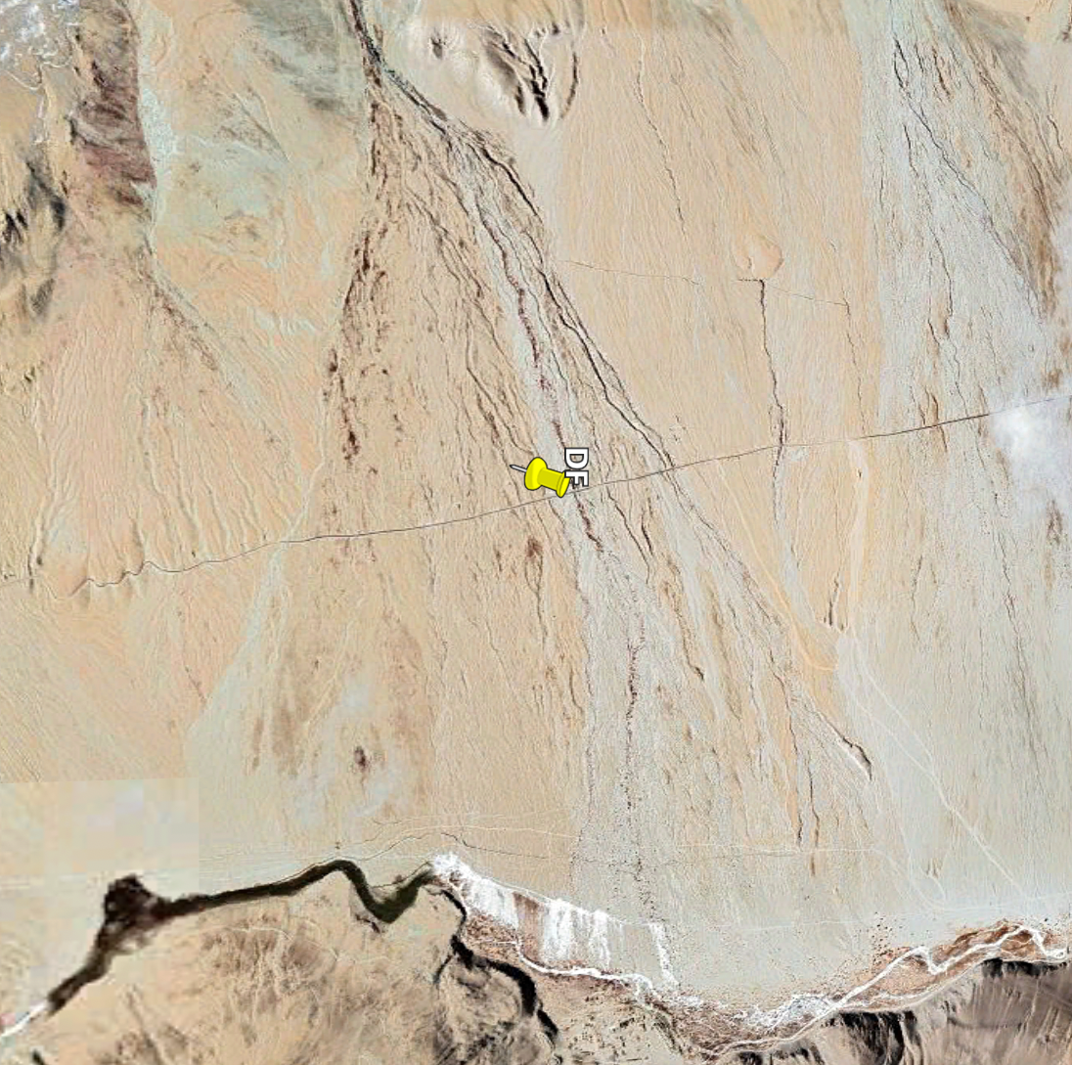
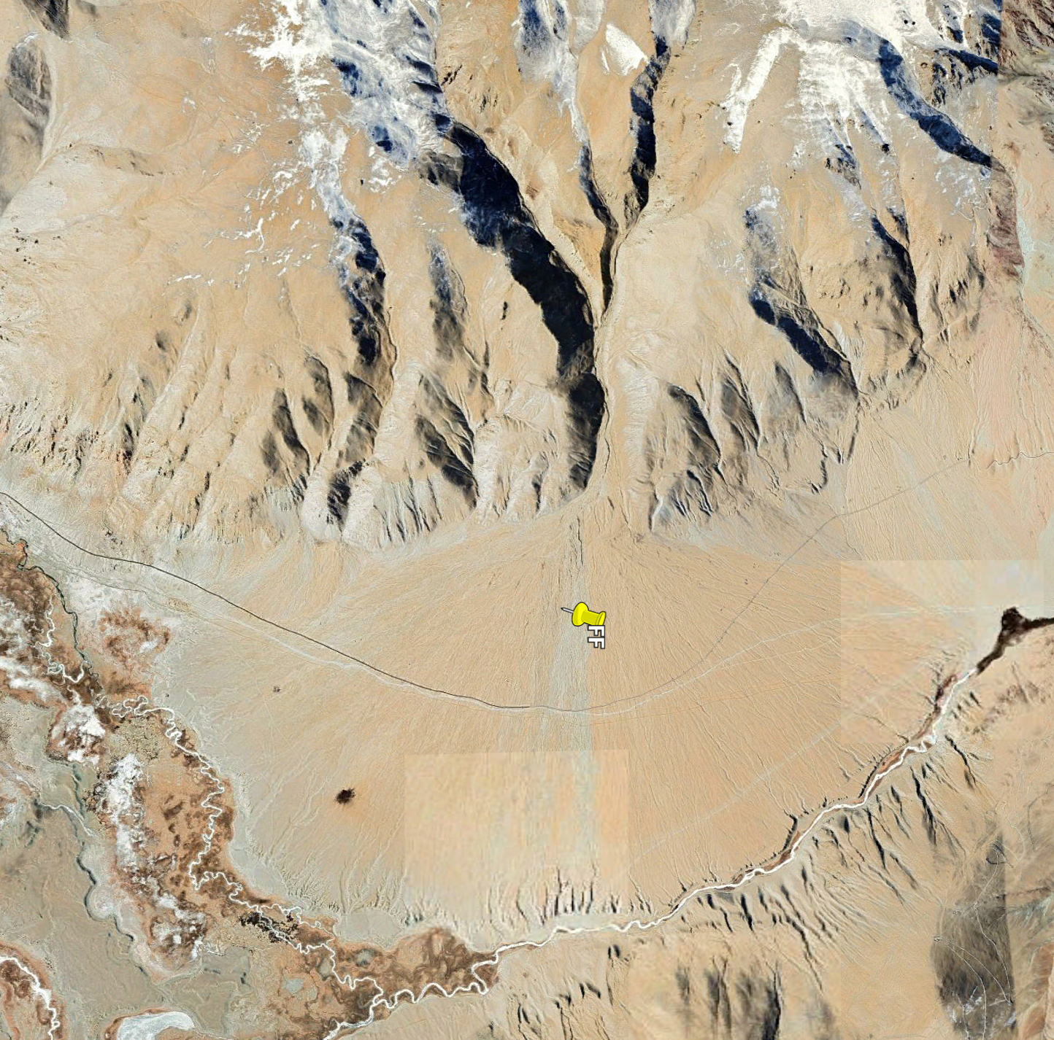
debris flow dominated
fluvial flow dominated
Image source: Google Earth

Slide 9
to use ML classifier to estimate probabilities of debris-flow vs flood dominated system
to identify the parameters, that matter for the classification
to see if adding climatic features affects the classification
to find out if there are any regional differences
to make projections based on climate scenarios
Research questions

Slide 10
🧐
📋
📋📋
🚀
🔧
⁉️
🪄
frame the
question
get data
clean up
split data:
train & test
machine learning:
build the model
tune the
model
evaluate
the model
make
predictions

Slide 11
🧐
📋
📋📋
🚀
🔧
⁉️
🪄
frame the
question
get data
clean up
split data:
train & test
machine learning:
build the model
tune the
model
evaluate
the model
make
predictions

Slide 12
🧐
📋
📋📋
🚀
🔧
⁉️
🪄
frame the
question
get data
clean up
split data:
train & test
machine learning:
build the model
tune the
model
evaluate
the model
make
predictions

Slide 13
🧐
📋
📋📋
🚀
🔧
⁉️
🪄
frame the
question
get data
clean up
split data:
train & test
machine learning:
build the model
tune the
model
evaluate
the model
make
predictions

Slide 14
🧐
📋
📋📋
🚀
🔧
⁉️
🪄
frame the
question
get data
clean up
split data:
train & test
machine learning:
build the model
tune the
model
evaluate
the model
make
predictions

Slide 15
🧐
📋
📋📋
🚀
🔧
⁉️
🪄
frame the
question
get data
clean up
split data:
train & test
machine learning:
build the model
tune the
model
evaluate
the model
make
predictions

Slide 16
🧐
📋
📋📋
🚀
🔧
⁉️
🪄
frame the
question
get data
clean up
split data:
train & test
machine learning:
build the model
tune the
model
evaluate
the model
make
predictions

Slide 17
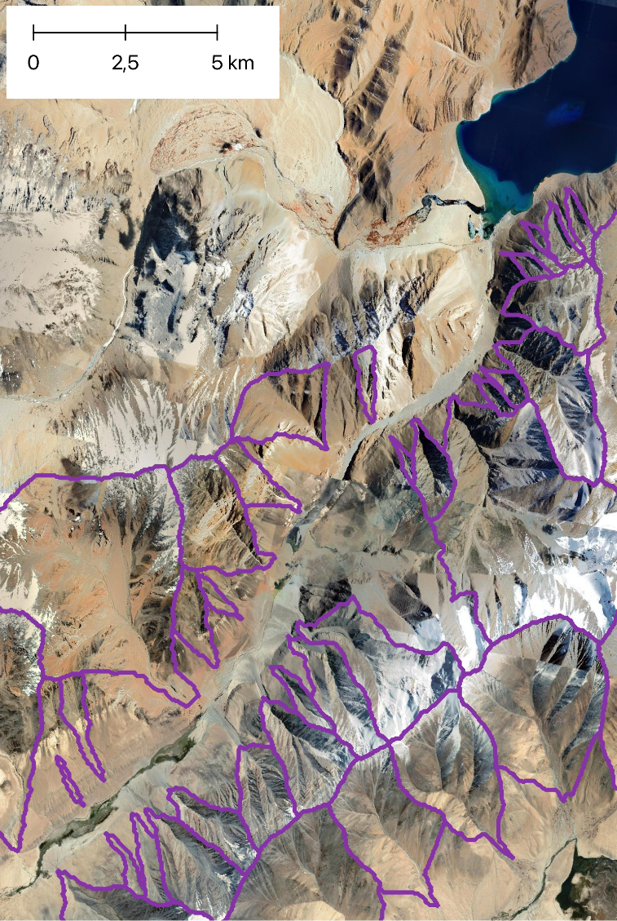
Morphometric + climate
mean_annual_temp
mean_jan_temp
mean_jury_temp
mean_monsoon_temp
mean_outside_monsoon_temp
temp_crosses_zero (frost cracking)
belowzero_fraction_of_year
mean_daily_precipitation
mean_annual_sum_precipitation
mean_daylymonsoon_precipitation
mean_monsoon_sum_precipitation
monsoon_precipitation_fraction
n_rainy_days (>10mm)
rainy_days_fraction
avgtemp_belowzero
glacier_area_sum
glacier_area_fraction
glacier
isolated_permafrost_area
sporadic_permafrost_area
discontinious_permafrost_area
continuous_permafrost_area
sporadic_permafrost_frac
discontinious_permafrost_frac
isolated_permafrost_frac
continious_permafrost_frac
all_permafrost_frac
cont_permafrost_frac > 50%
any_permafrost
712 catchments in total
from different parts of HMA
x_centroid
y_centroid
area_m
perimeter
mean_elevation
median_elevation
std_elevation
min_elevation
max_elevation
range_elevation (relief)
variance_elevation
mean_slope
median_slope
std_slope
min_slope
max_slope
range_slope
variance_slope
Melton_ratio (relief*area^{0.5})
circularity_ratio
compactness_coefficient
region
Morphometric

Slide 18
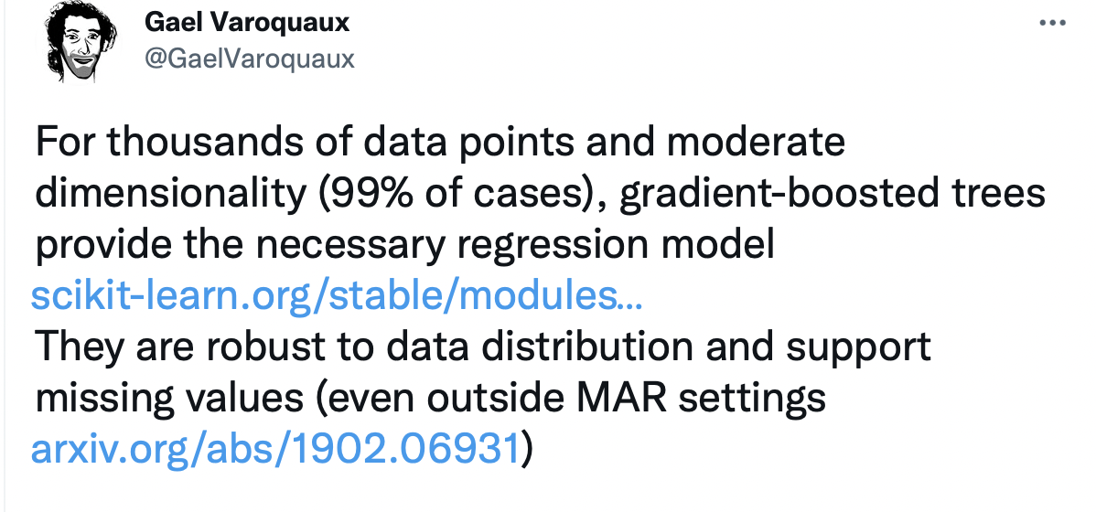
*
* MAR = Missing At Random

Slide 19
Gradient boosted decision trees
Dataset
“Weak learner”
Trying to minimize the “loss function” (function, that describes the error) on every iteration
Each weak learner (i.e. tree/iteration) is trying to learn what did the previous one did “wrong” and do better
The final model is the “combination” of all weak trees to build a strong classifier
Residuals
Prediction

Slide 20
Gradient boosted decision trees
Dataset
“Weak learner”
Trying to minimize the “loss function” (function, that describes the error) on every iteration
Each weak learner (i.e. tree/iteration) is trying to learn what did the previous one did “wrong” and do better
The final model is the “combination” of all weak trees to build a strong classifier
Residuals
Prediction

Slide 21
Gradient boosted decision trees
Dataset
“Weak learner”
Trying to minimize the “loss function” (function, that describes the error) on every iteration
Each weak learner (i.e. tree/iteration) is trying to learn what did the previous one did “wrong” and do better
The final model is the “combination” of all weak trees to build a strong classifier
Residuals
Prediction

Slide 22
Gradient boosted decision trees
Dataset
“Weak learner”
Trying to minimize the “loss function” (function, that describes the error) on every iteration
Each weak learner (i.e. tree/iteration) is trying to learn what did the previous one did “wrong” and do better
The final model is the “combination” of all weak trees to build a strong classifier
Residuals
Prediction

Slide 23


Implementation: Catboost
Dataset
“Weak learner”
Residuals
Does a good job as an “out of the box” tool
Supports categorical features (predictors) as an input
Prediction

Slide 24
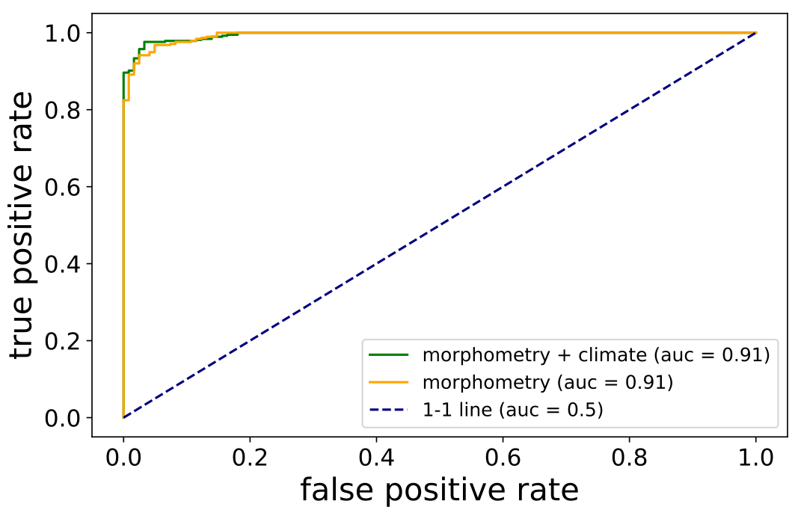
Building the model: how good is it?
Morphometric
Accuracy : 91 %
(fraction of correct predictions)
Confusion matrix: [145., 28.]
[ 17., 522.]
Morphometric + climate
Accuracy: 92 %
Confusion matrix: [148., 25.]
[ 14., 525.]
TP
FN
auc = area under curve
only “tuned” parameter: number of trees (iterations)
debris flow (1): 539, flood (0): 173
accuracy, when guessing randomly: 75.7 %
FP
TN

Slide 25
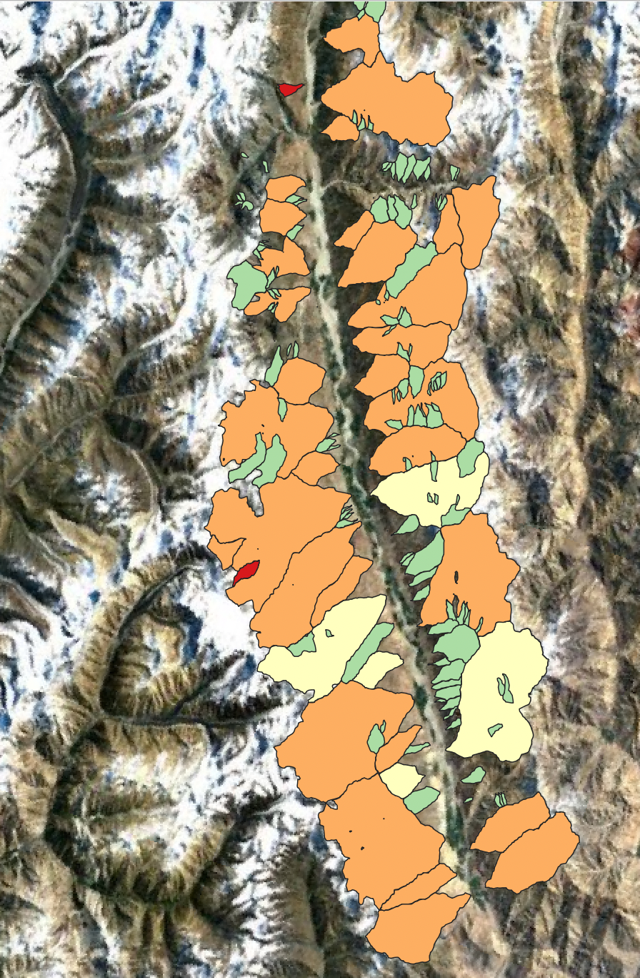
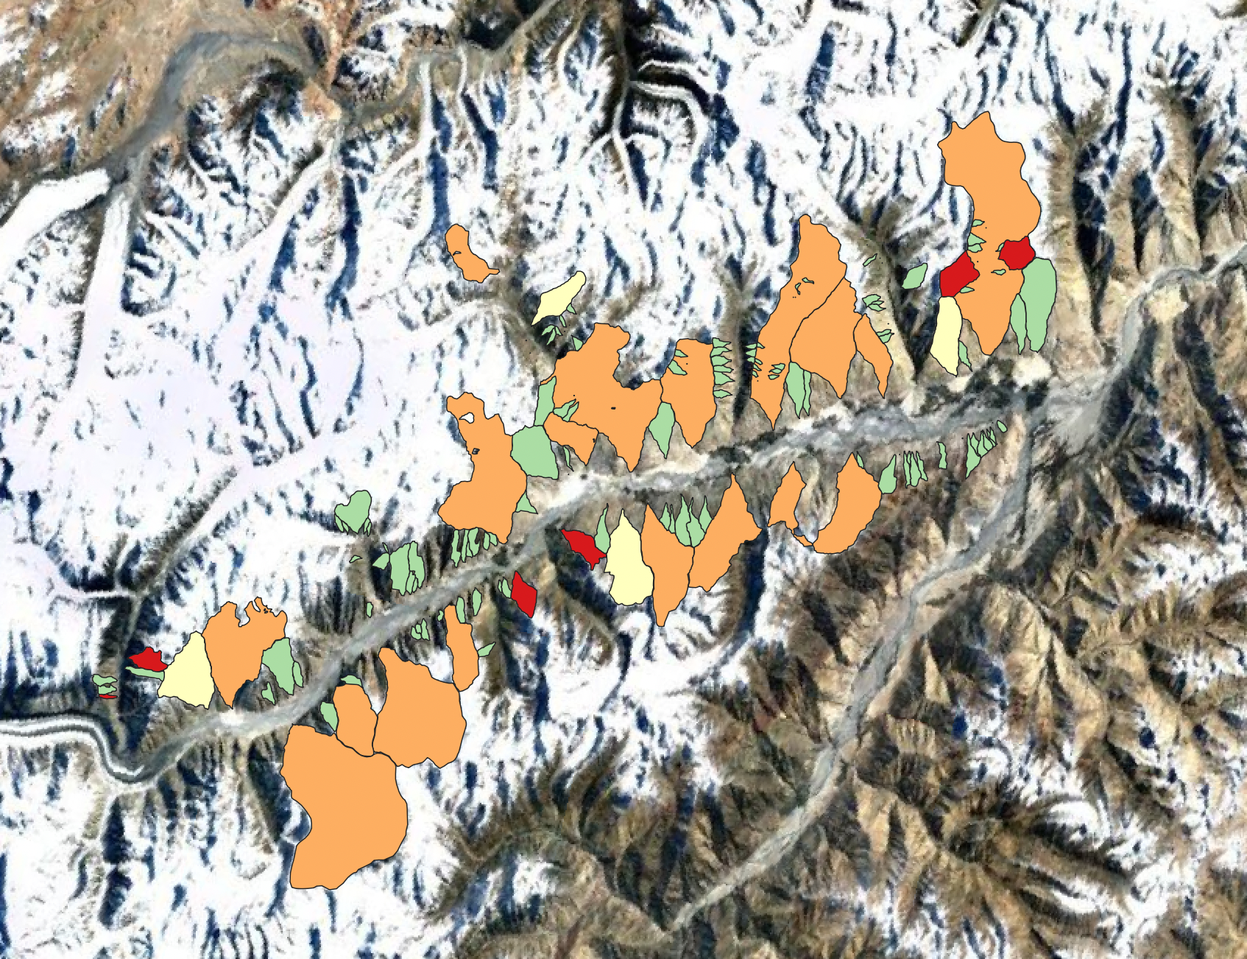
True positive
False positive
True negative
False negative
somewhere in Tajikistan
somewhere in Karakoram

Slide 26
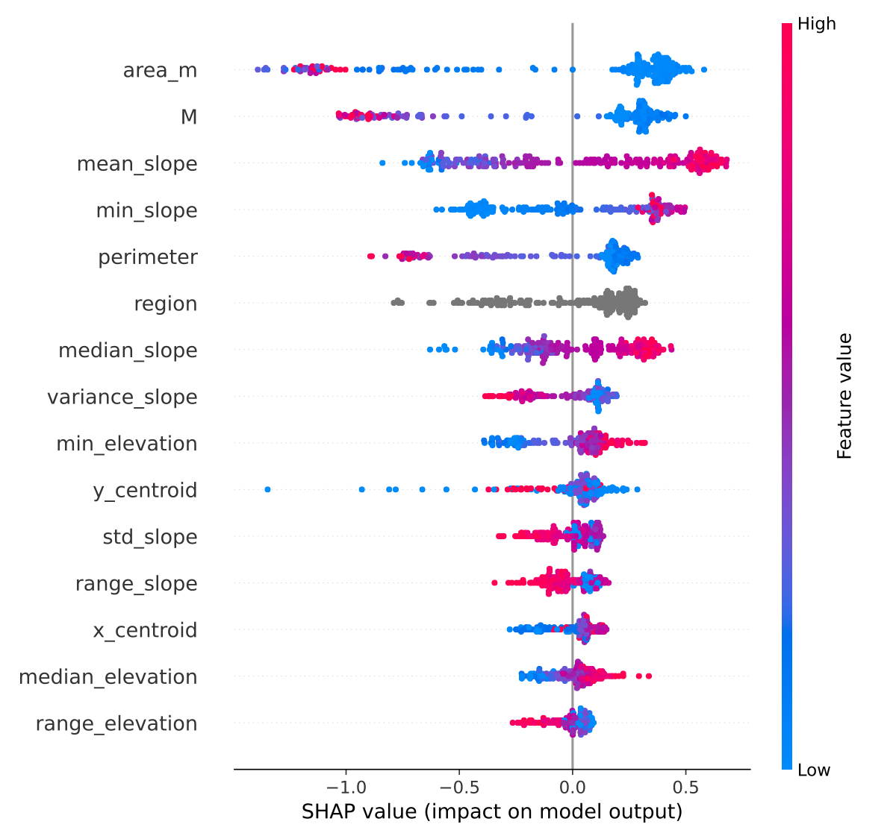
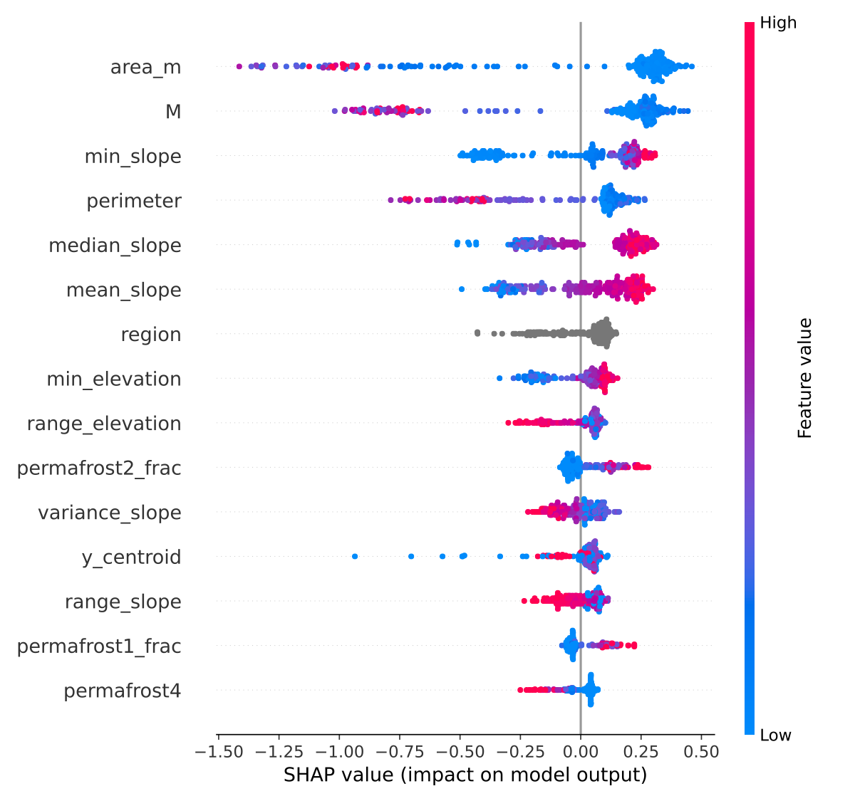
Why does Catboost model make this predictions?
Morphometric
Morphometric + climate

Slide 27
Why does Catboost model make this predictions?
Morphometric
Morphometric + climate

Slide 28
Why does Catboost model make this predictions?
Morphometric
Morphometric + climate

Slide 29
Why does Catboost model make this predictions?
sporadic_permafrost_frac
isolated_permafrost_frac
continious_permafrost_area
Morphometric
Morphometric + climate

Slide 30
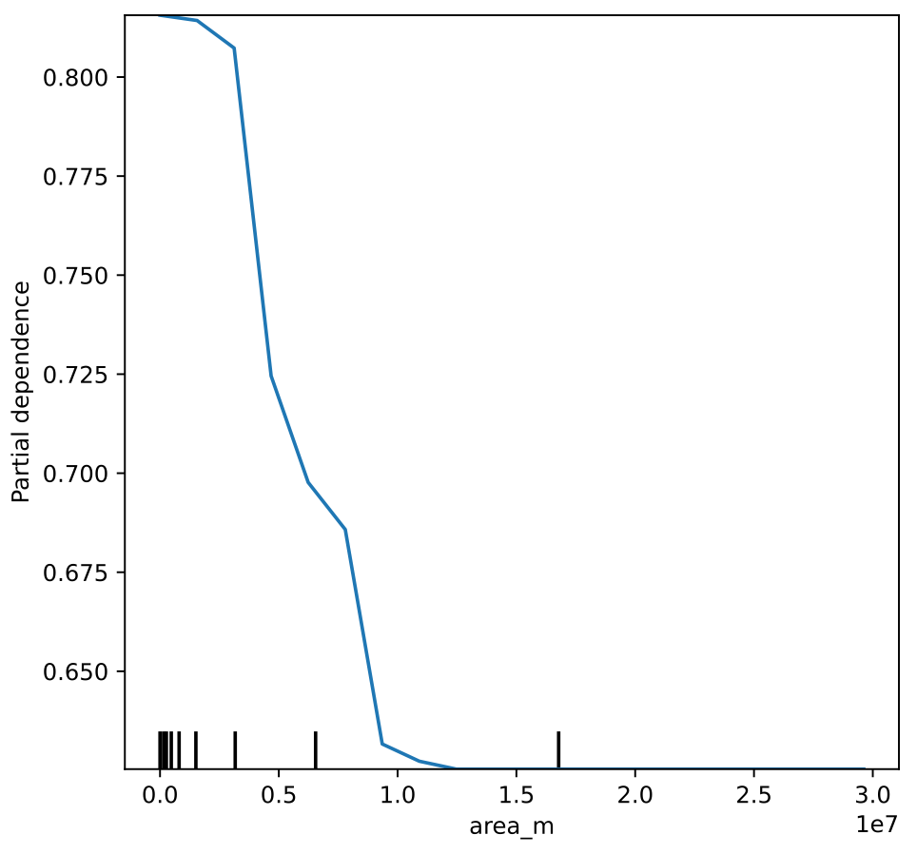
What should we do to the catchment for it to “switch”:
all things being equal, how can we make a “flood” catchment produce “debris flow”
average probability of a DF (1)
for scenario, where all catchment
have the same area (x-axis)

Slide 31
Conclusions
We can build a machine learning classifier for distinguishing debris-flow dominated systems from flood dominated ones
Climate data adds a lot of information to the model, but (all other things being equal) does not improve model performance
Outlook
Extend the dataset for “creating” the model by covering more diverse regions
Add vegetation cover to the feature list
Apply the model to the “new” areas (i.e. catchments without alluvial fan)
To see the effect of the climate change - use RCP scenarios as a climate information

Slide 32
